Slide 1
PSHE and Citizenship
Health and Wellbeing | Think Positive
PSHE and Citizenship | KS1 | Health and Wellbeing | Think Positive | Think Happy, Feel Happy | Lesson 1

Slide 3
Aim
I understand how happy thoughts can make me feel better.
Success Criteria
I can describe different emotions and consider how to deal with different feelings.
I can identify positive and negative thoughts.
I can think of different, more positive ways, to think about things.
This resource is fully in line with the Learning Outcomes and Core Themes outlined in the PSHE Association’s Programme of Study.

Slide 4
The Big Questions

Slide 5

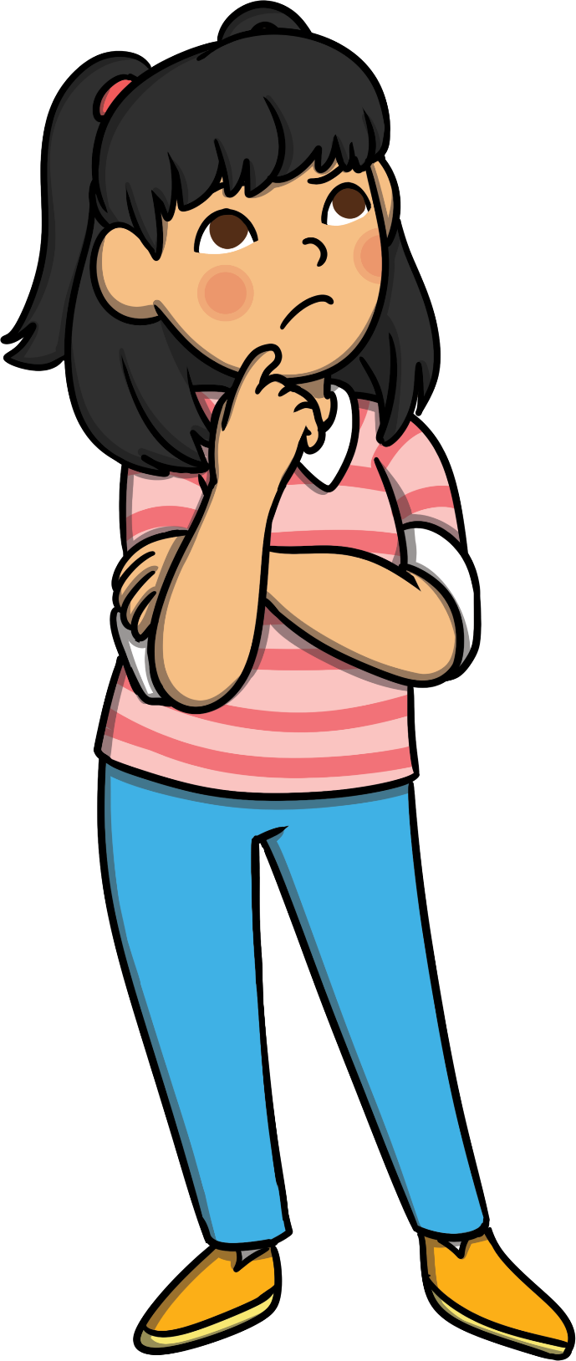
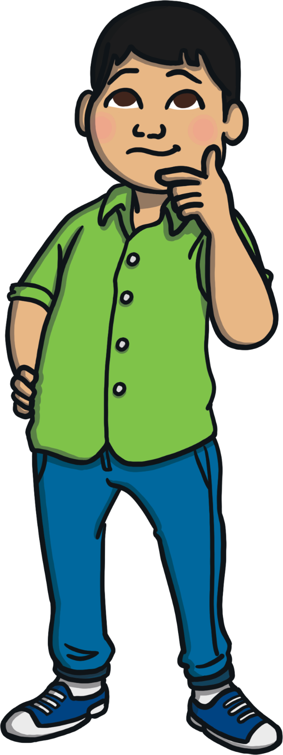
What is positive thinking?
How can it help us feel good?

Slide 6
Reconnecting

Slide 7

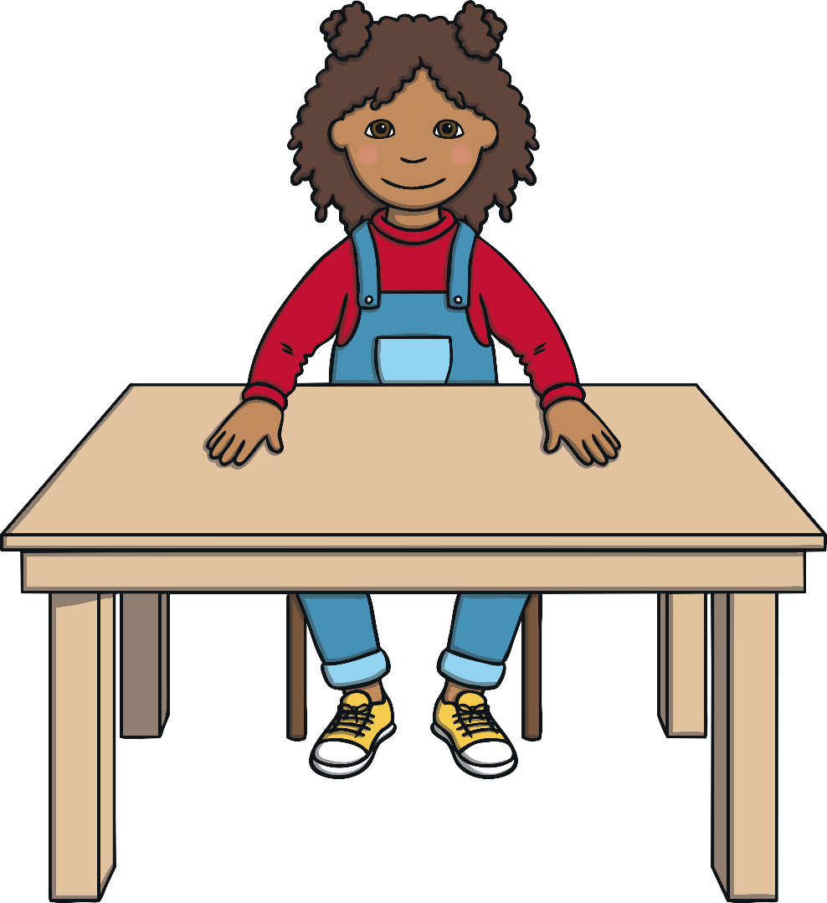
Think a Happy Thought
Let’s all sit very quietly.
Try to clear your mind.
If it helps, you can close your eyes.
Now, think of a happy thought…
This could be something you are looking forward to or a happy occasion that you were part of.
It might be a thought about a particular person or place that makes you feel happy.

Slide 8
Exploring

Slide 9

What Is Positive Thinking?
What is positive thinking?
Well, being positive means looking for the good in things, rather than the bad.
A positive thinker focuses on making the best of a situation, rather than complaining about it.
Positive thinkers are said to ‘look on the bright side’.

Slide 10
What Is Positive Thinking?
Can you think of positive words?
These are words we might use if we are thinking positive, happy thoughts, rather than complaining and being grumpy.
Tell your partner a positive word you might use if you were sharing a happy memory or talking about a person or place that makes you happy.
Did you get any of these?
enjoy
smile
good
fantastic
brilliant
amazing
special
love
great
nice
better
laugh
best

Slide 11

Positive Thoughts
Have you ever looked outside when it’s been raining and felt a bit down, because it means you can’t go out to play? That’s the down side of rain, but there is an up side, too.
A positive person might say to themselves,
‘What great weather for all the plants that need a drink!’

Slide 12
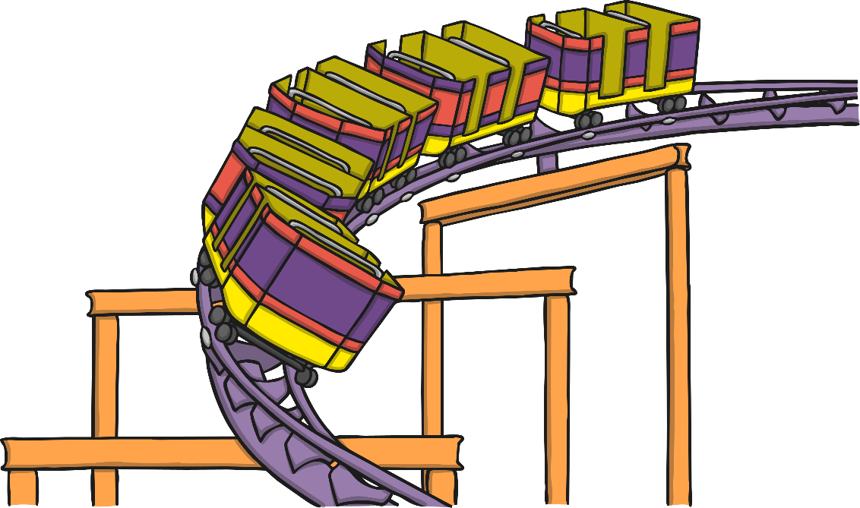
Positive Thoughts
Imagine you are having an exciting day out, at the park, beach or fun fair. You have had a great morning and it is now lunchtime.
Some people might feel a bit sad that the morning has gone and that they now only have half a day left until home time. They are focusing on the negative, not the positive.
A positive thinker would say,
‘What a great morning – and we still have the whole afternoon left to enjoy!’

Slide 13
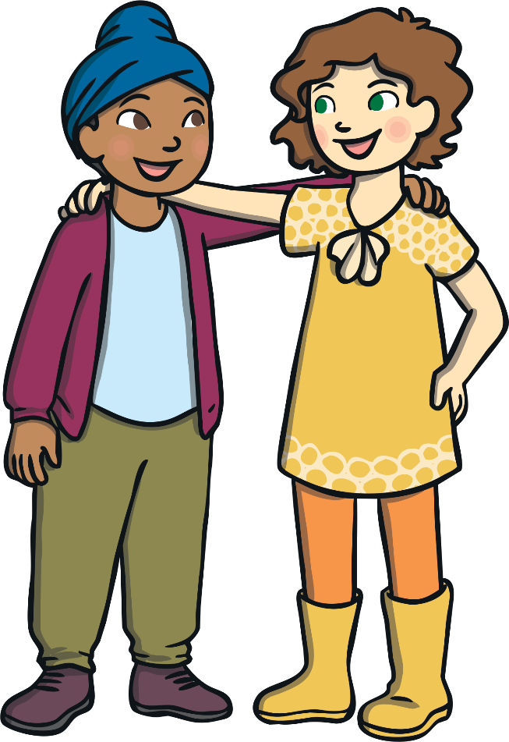
Positive Thoughts
How many of you have had a friend over to play, then made a bit of a grumpy fuss when it is time for them to go home?
Well, a positive thinker might say to themselves,
‘I had a great time with my friend. I hope they can come round again, or I might get invited to their house.’

Slide 14
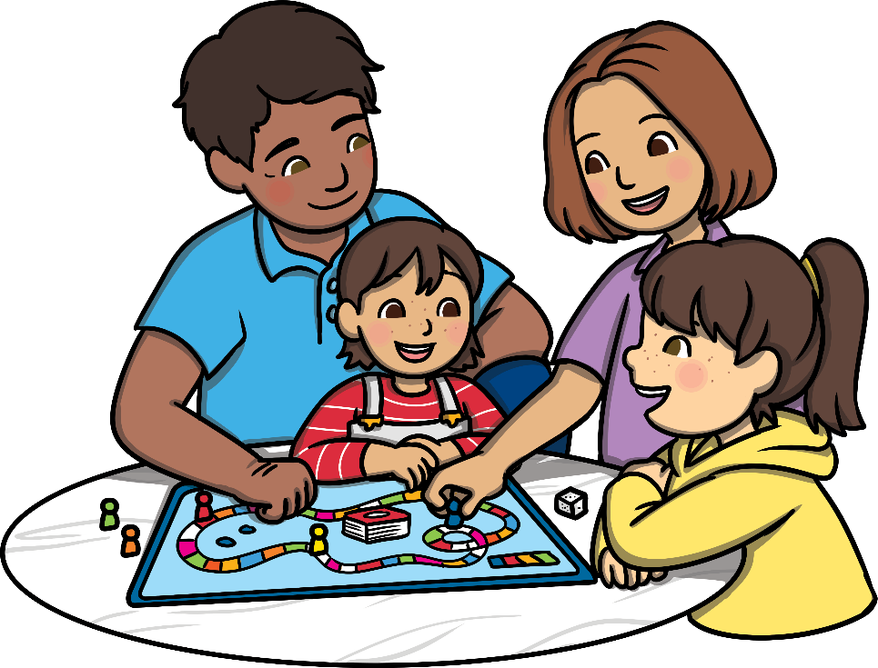

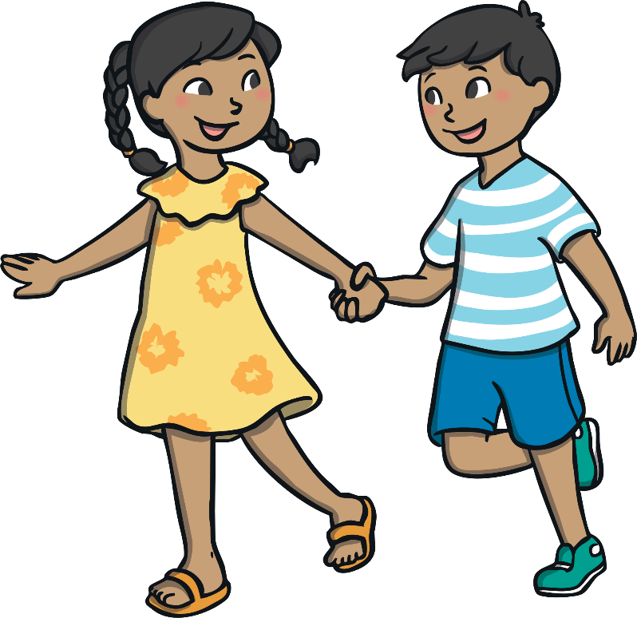
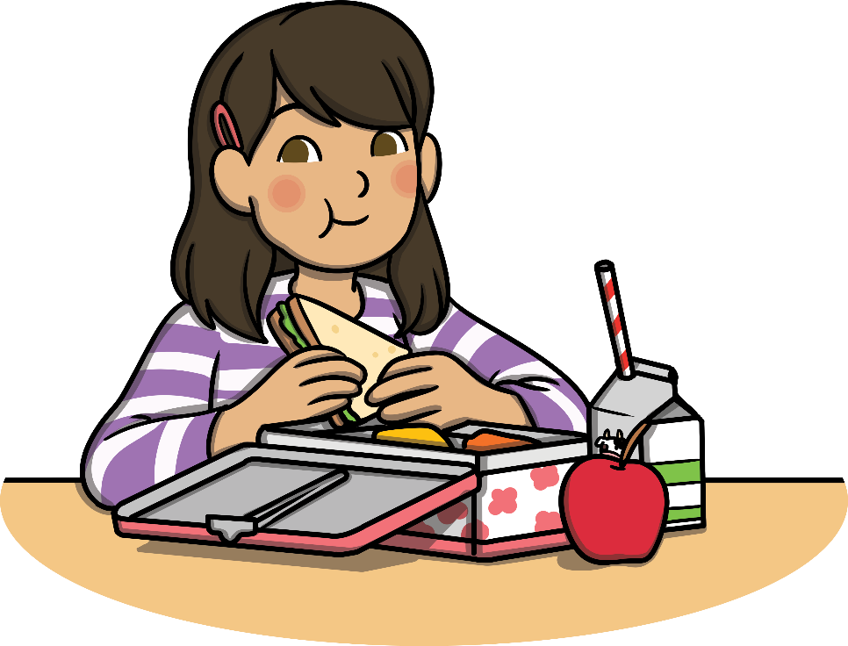
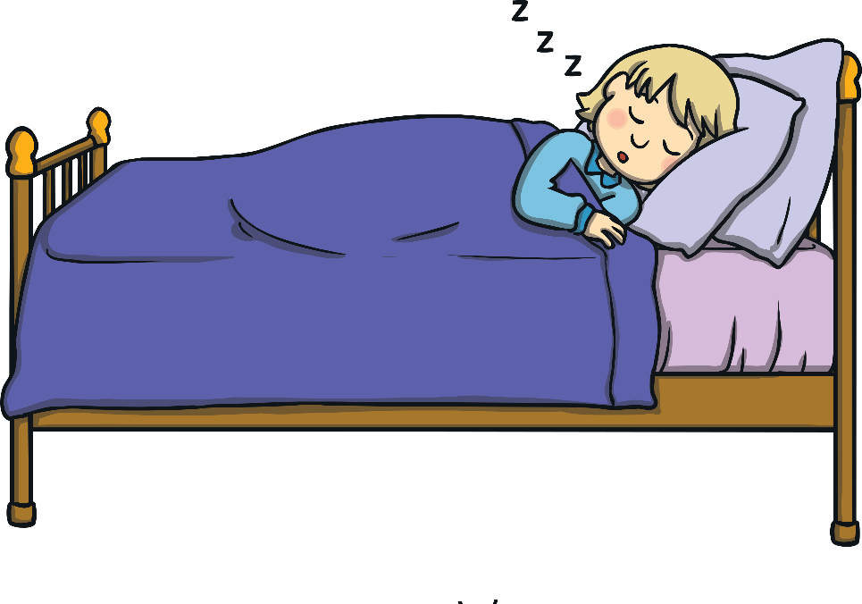
Positive Thoughts
There are lots of ways we can help ourselves to feel good. We can:
play outside
do things we enjoy
spend time with family
eat a balanced diet
get enough sleep
Thinking happy thoughts is one way we can help ourselves to feel good. Let’s do it!

Slide 15

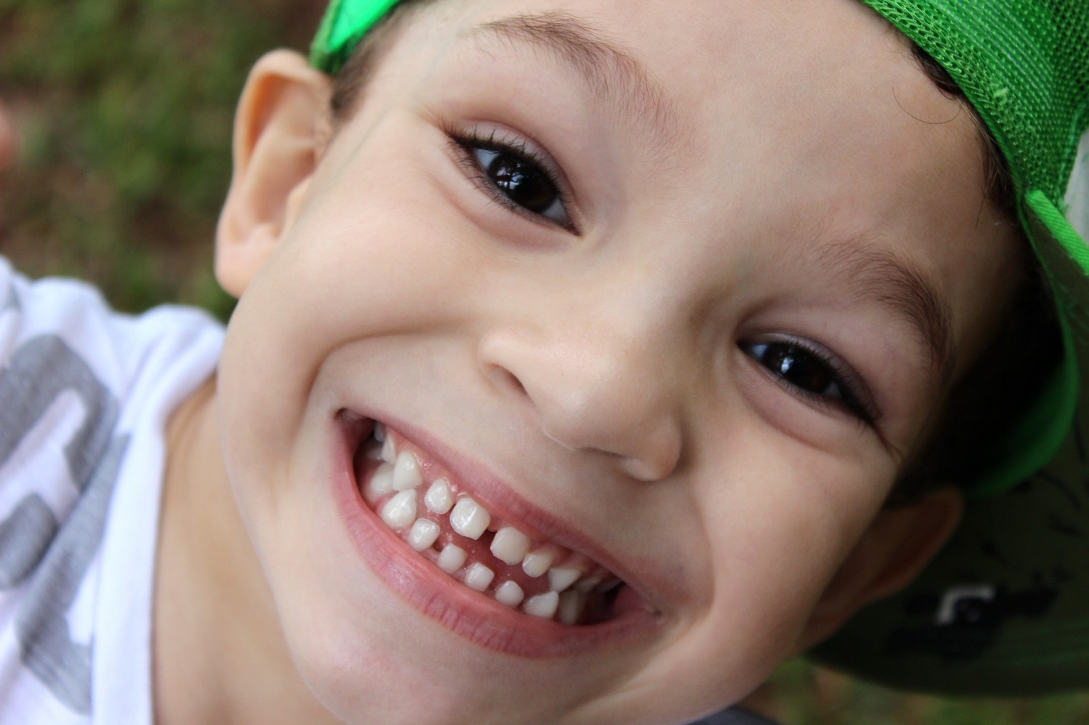
Think Happy, Feel Happy
Consolidating
Reflecting

Slide 16
Consolidating

Slide 17

Every Cloud Has a Silver Lining
There is a saying, “Every cloud has a silver lining.”
People think of clouds as grey and grumpy. They block the sunshine and are often full of rain to spoil the day.
But lots of people say that even in a grey and grumpy cloud, there is something good (that’s the silver lining).
So you can usually find something that is good about a tough situation if you look hard enough.

Slide 18

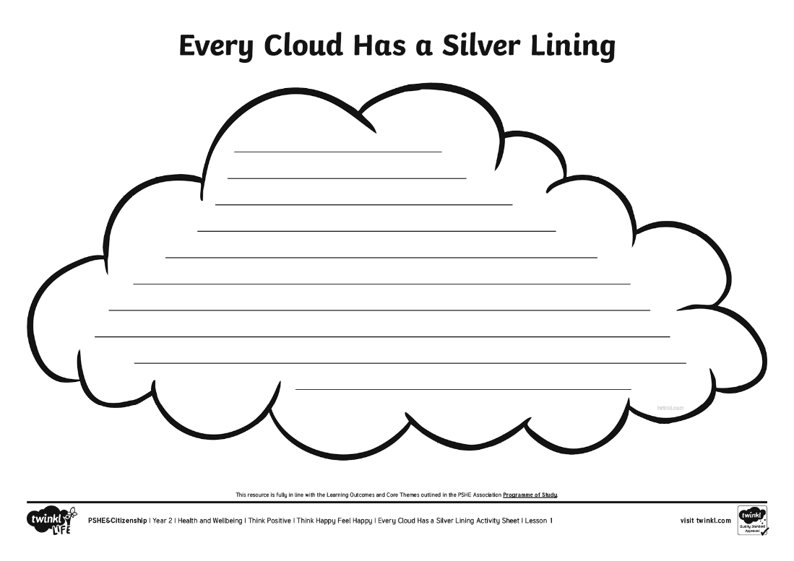
Every Cloud Has a Silver Lining
Each of you has a cloud shape to write on.
Listen to this story and how the child in the story feels. See if you can find a positive thought to write on your cloud, looking for the good in the situation, instead of focusing on the bad.

Slide 19

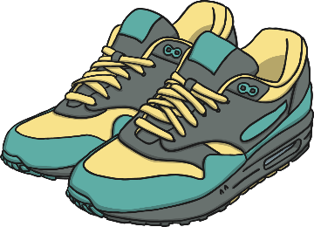
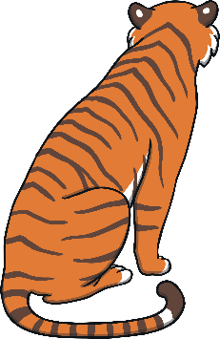

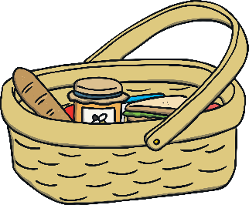
Every Cloud Has a Silver Lining
Jude is off to the zoo with Dad. It is summer
but the sun is behind the clouds.
Dad won't let Jude wear the new trainers they bought at the weekend.
Jude really wants to see the big cats, such as tigers, leopards and lions but last time they were all asleep in the shade, at the back of their enclosures, so no one could see them.
Dad has forgotten the picnic and the camera!

Slide 20
Every Cloud Has a Silver Lining
So Jude seems to be focusing on the negative things about the day – things that have gone wrong or things that might spoil the day.
Can you think of some positive thoughts Jude could have about
the situation?
What is good about the sun being behind the clouds?
What is good about not being allowed to wear the new trainers?
What might happen today with the big cats?
What could Jude and Dad do instead of having a picnic?
What could Jude and Dad do instead of taking photos?

Slide 21


Every Cloud Has a Silver Lining
What sort of a day will Jude and Dad have if they focus on the negative thoughts and things that have gone wrong?
What sort of day will Jude and Dad have if they look for the positives and try to look on the bright side?

Slide 22
Reflecting

Slide 23

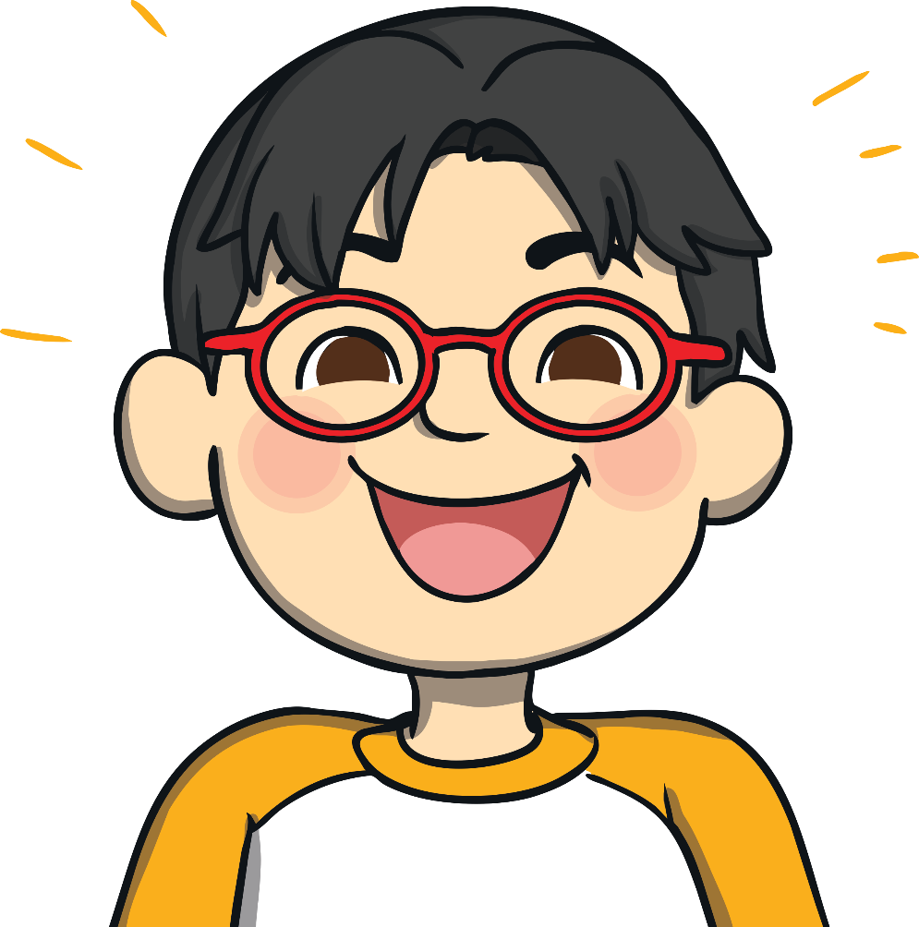
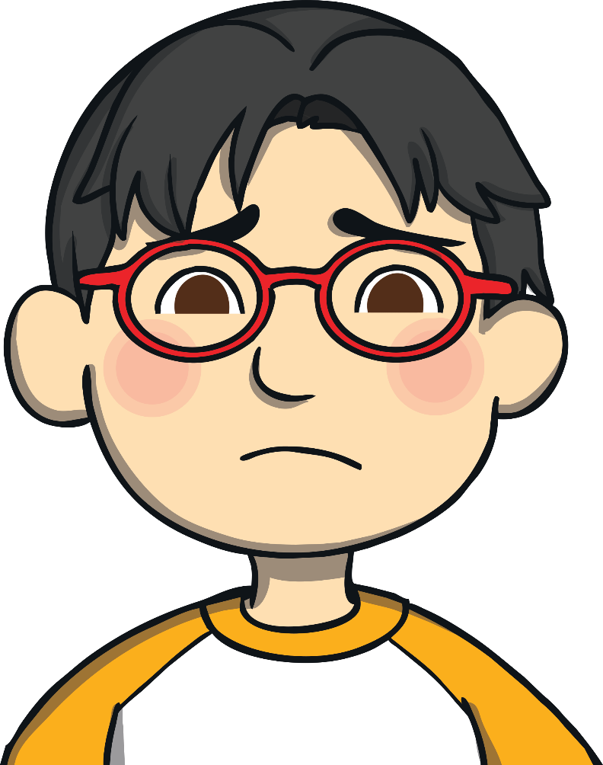
Turn That Frown Upside Down!
Help this negative person to look on the bright side.
Help them to think positively about their situations.
Listen to what they say, then work with your talk partner to think of something positive they could say instead.
If they think happier thoughts, they’ll feel better and their frown will become a smile.

Slide 24
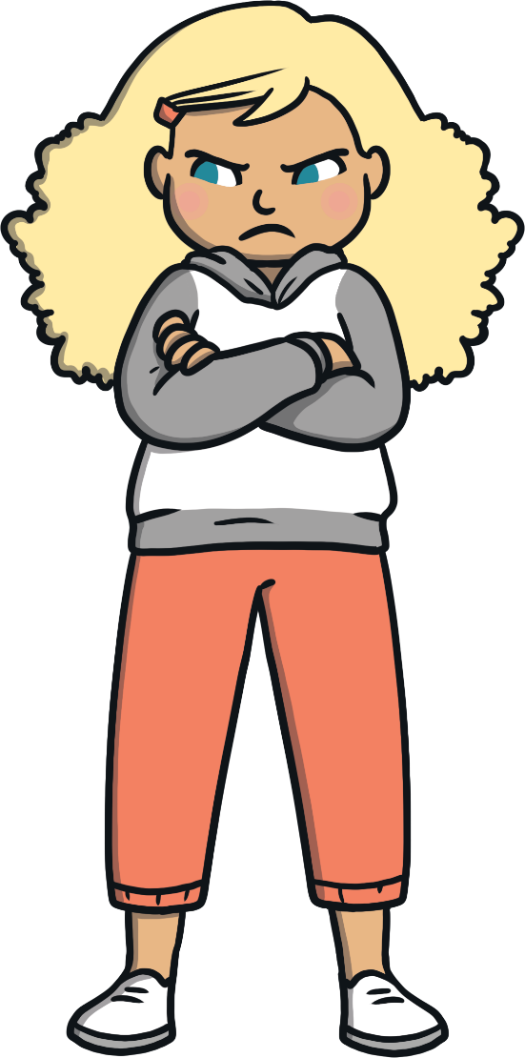
Turn That Frown Upside Down!
I don’t like it when it’s dark at night.
I hate the night I have to eat broccoli for tea!
Oh no! My best friend is off school today because they are ill.
This lesson is so hard. I’ve never done these sorts of calculations before.
My favourite
T-shirt is too small and I can’t wear
it anymore.

Slide 25
The Big Questions

Slide 26

What is positive thinking?
How can it help us feel good?

Slide 27
Aim
I understand how happy thoughts can make me feel better.
Success Criteria
I can describe different emotions and consider how to deal with different feelings.
I can identify positive and negative thoughts.
I can think of different, more positive ways, to think about things.

