Slide 1
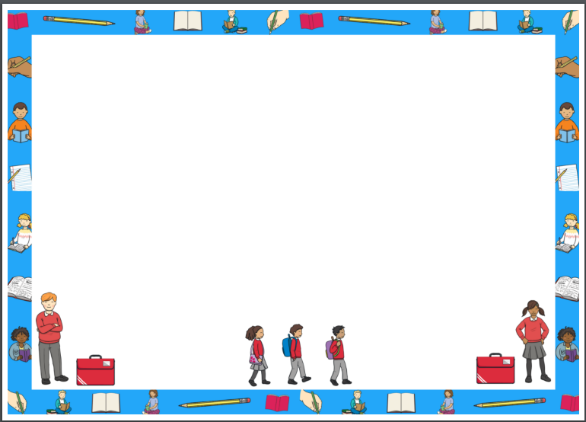


You are coming back to school soon!

Slide 2

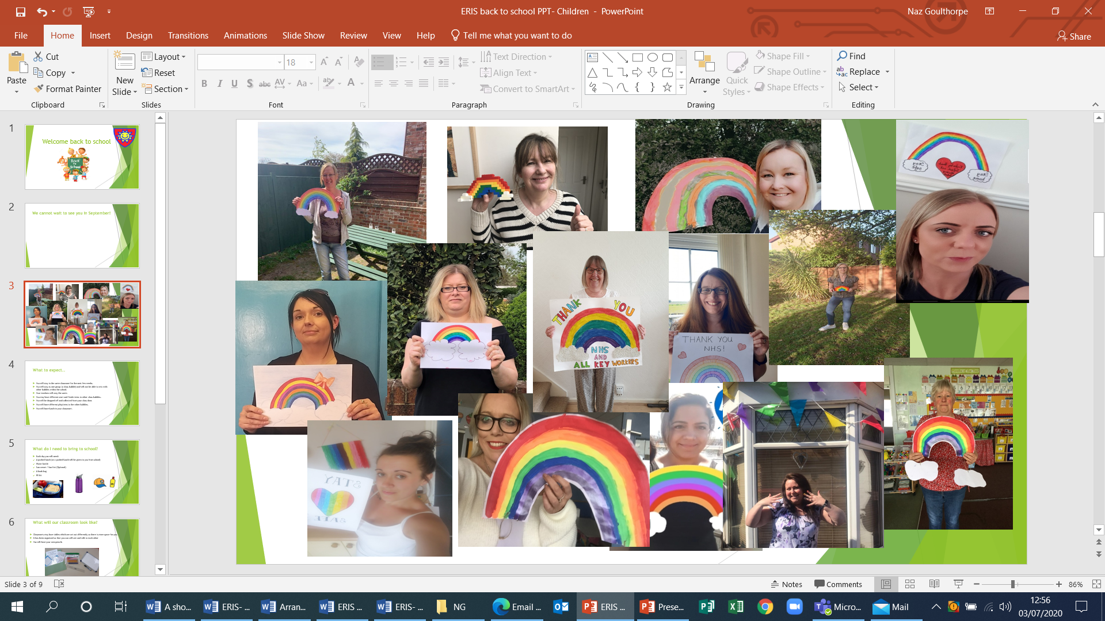
We cannot wait to see you in September!

Slide 3
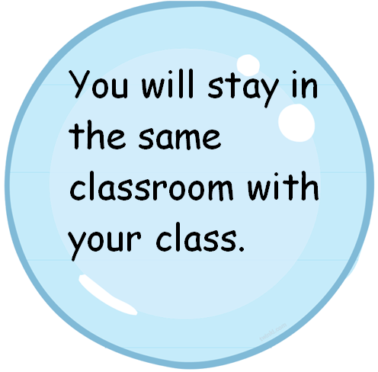


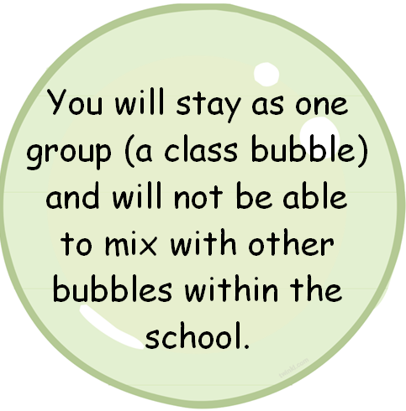

What you will find in September:

Slide 4
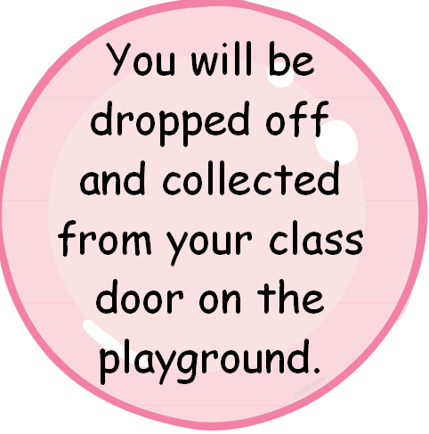
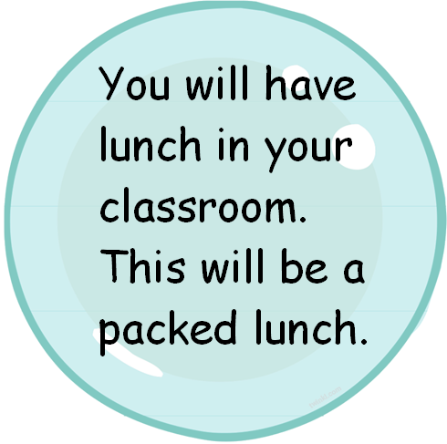

What you will find in September:

Slide 5
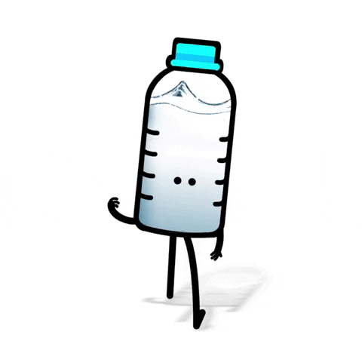
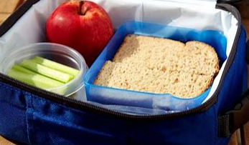

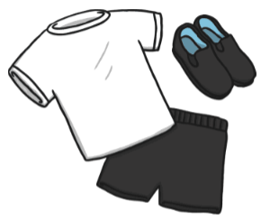

What you should bring to school:
A packed lunch
(or a packed lunch will be given to you from school)
Water bottle- make sure
this has your name on
Sun cream / Sun Hat
(Optional)
A book bag
PE kit

Slide 6
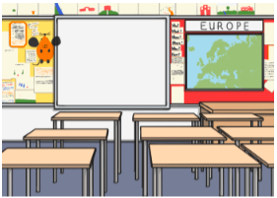

What the classrooms will look like:
Classrooms may have tables which are set out differently so there is more space for you. It has been organised so that you can still see and talk to each other.
You will have your own
pencils.

Slide 7

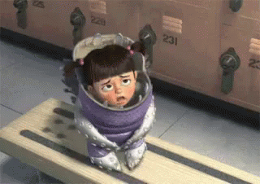
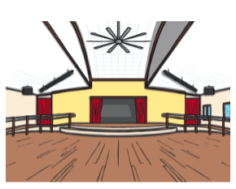
Other changes in school:
You will only use the toilets located just outside your classroom. These are just for
1 class to use.
Whole school assemblies will not be taking place but you will have your own assembly in the classroom and sometimes in the hall.

Slide 8

New School Rules:
We will also be following some new rules called ERIS.
These rules are to help you keep safe.
Expected- I am expected to follow the adults instructions all of the time.
Remember- I will remember to wash my hands regularly.
Important- It is important that I use a tissue if I cough or sneeze and
I ‘catch it, bin it, kill it’.
Safe- I can keep myself and my bubble safe by letting the adult know if I don’t feel well.

Slide 9

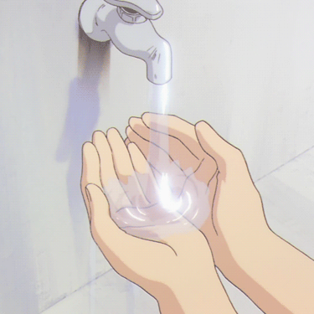
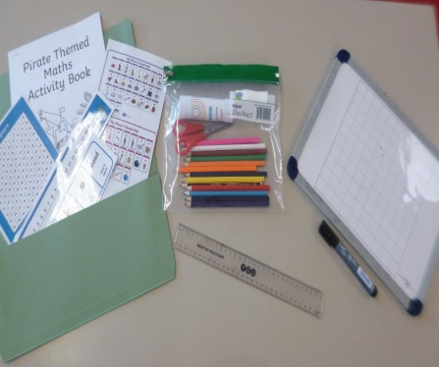


How you can keep safe at school:
Wash your hands when you enter and exit the school, before and after break and lunch, when you go to the toilet and if you sneeze or cough.
You will have your own work space and your own resources
including pencils. The desks and chairs will be cleaned every
lunch time before the afternoon session as well as being
cleaned after school, ready for the next day.
The equipment that is used during break, lunch and P.E. will be cleaned after each session.

Slide 10

We cannot wait to see you in school!

