Slide 1

Phonics Screening
Year 2
A guide for parents.

Slide 2
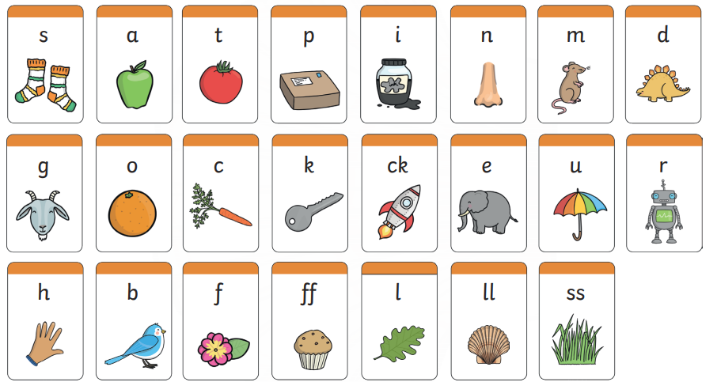
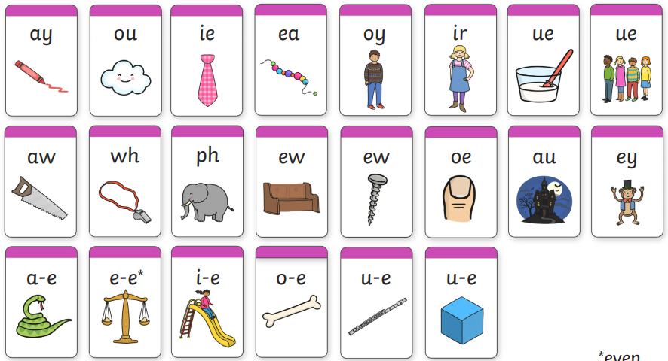
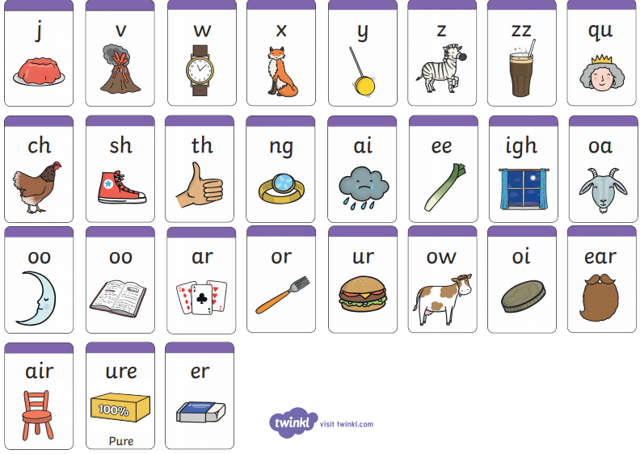
What is Phonics?
Children are taught to read by breaking down (segmenting) words into separate sounds or ‘phonemes’. They are then taught how to blend these sounds together to read the whole word.
Children in Key Stage 1 have a phonics lesson daily and they are encouraged to use these strategies to read and write in other lessons.

Slide 3
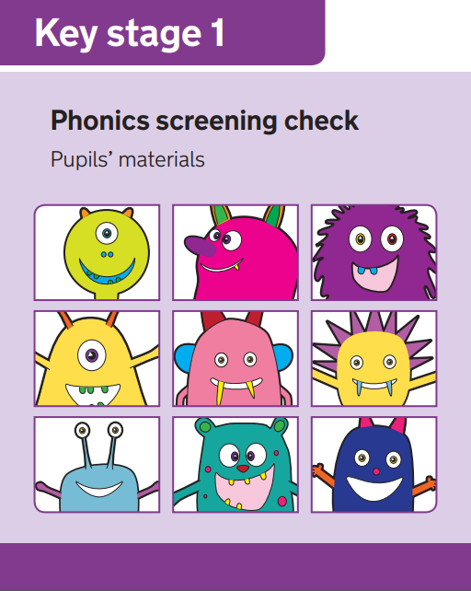
What is the aim of the check?
The Phonics Screening Check is designed to confirm whether individual children have learnt phonic decoding (i.e. apply their knowledge of letter-sound relationships) and blending (i.e. the skill of joining individual speech sounds (phonemes) together to make a word) skills to an appropriate standard
This ‘mid-point’ check will allow teachers to ensure that any gaps in children’s knowledge is filled by the end of Year 2.

Slide 4

When will the screening happen?
Every Year 2 child in the country will be taking the Phonics Screening Check in November to make up for the missed check in June.
Those Year 2 children who don’t pass will be taking the check again later in the school year.
The results will be reported to parents as part of the annual school report.

Slide 5
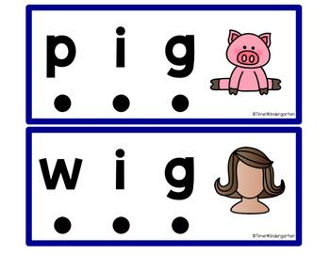
What do we expect children to do?
The check is very similar to tasks the children already complete during phonics lessons
Children will be asked to ‘sound out’ a word and blend the sounds together, eg d-o-g - dog
The focus of the check is to see which sounds the children know
THIS IS NOT A READING TEST

Slide 6
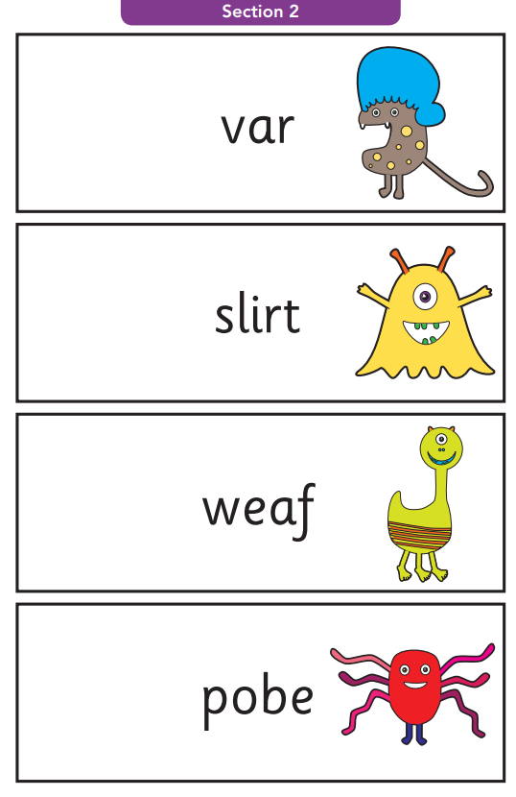
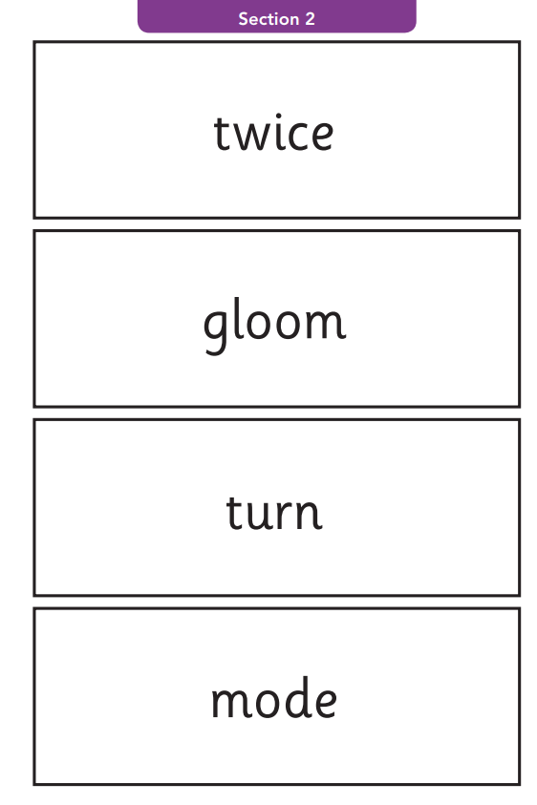
Example words
Alien/Pseudo words
Real words

Slide 7

How will the children complete the check?
The children will complete the check one at a time in a quiet area of the school.
The screening will only take 5-10 mins with each child.

Slide 8
How can you help?
The way in which you learnt to read, is probably very different from the way we teach children to read now, so here is a quick guide to some of the things you can do to help you child in preparation for the Screening Check.
Remind your child to look for the following when faced with an unfamiliar word (real or alien/pseudo)
  Look for any familiar digraphs first, then any trigraphs, then any split digraphs. What ever is left are single phonemes.
Encourage children to use sound buttons when breaking the words down.
  A dot for a single phoneme, a small line for a digraph/trigraph and a hook for an split digraphs. These should all be placed under the letters in the word. (see next slide for information on sound buttons)
Play some online game
  Please see the Phonics section on the school website for links to online games.

Slide 9
Using sound buttons
We use sound buttons to help children recognise the different parts of a word. (single phonemes, digraphs, trigraphs and split digraphs)

Slide 10


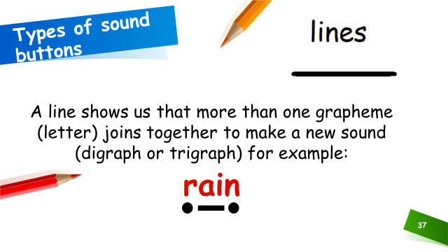
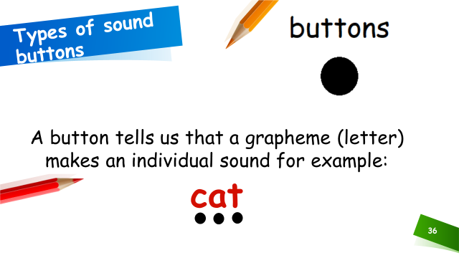
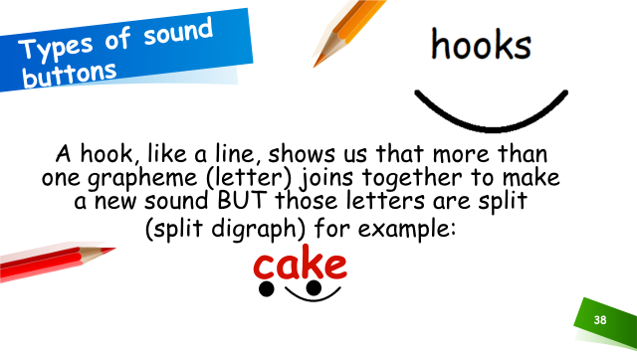
Using sound buttons

Slide 11
Useful websites
Here are some links to helpful website that give more information on the teaching of Phonics:
  Oxford Owl
https://home.oxfordowl.co.uk/reading/learn-to-read-phonics/
  Phonics Play:
https://www.phonicsplay.co.uk/InteractiveResources.htm
  YouTube – phoneme pronunciation:
https://www.youtube.com/watch?time_continue=18&v=UCI2mu7URBc&feature=emb_logo

Slide 12
Online Phonics Games
Click on the links below to access free phonics games.
Phonics Bloom
Education.com
Top Marks

Slide 13
Questions
If you have any questions regarding the Phonics Screening Check, please contact the school office and arrange a telephone appointment with your child’s class teacher.

Slide 14

Thank you
Thank you for your ongoing support

