Slide 1
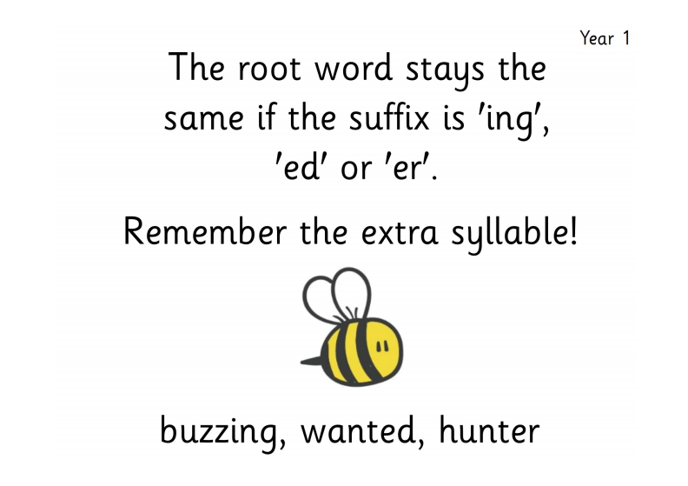

Slide 2
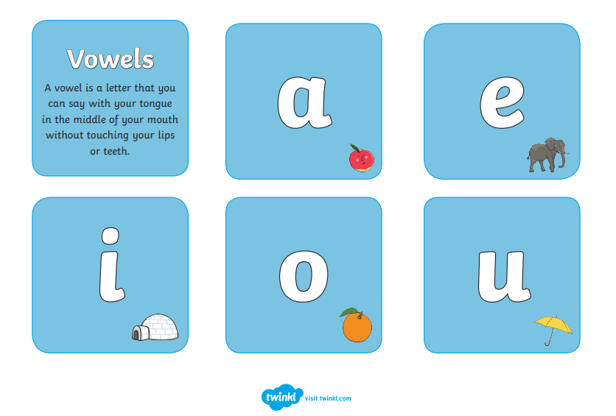
What is a consonant?
Consonants are all non-vowel sounds in the English alphabet.

Slide 3
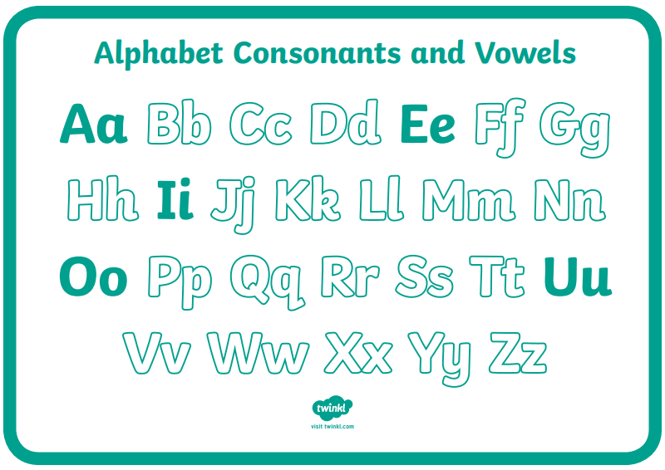
Consonants are all non-vowel sounds in the English alphabet.
Read the consonants as they are revealed

Slide 4
So what is a suffix?
A suffix is a letter or group of letters that goes on the end of a word and changes the word's meaning.
The suffixes we are going to focus on today are....
er
ing
ed

Slide 5



Adding 'er'
Adding ‘er’ to a verb can tell you what job somebody has or is doing.
He is a
painter.
She is a
builder.
He is a
teacher.

Slide 6

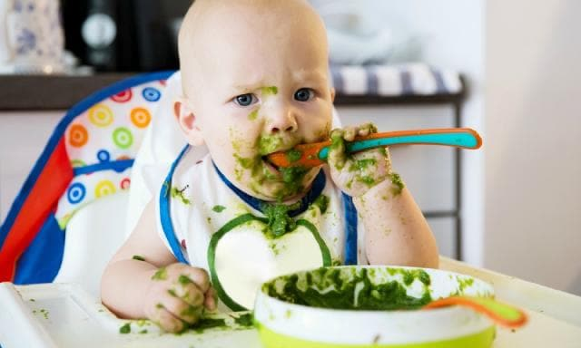

Adding 'ing'
Adding ‘ing’ can change a noun into a verb e.g. 'garden' to 'gardening' or it can tell you what is happening in the present.
jump -------> jumping
eat -------> eating
read -------> reading

Slide 7

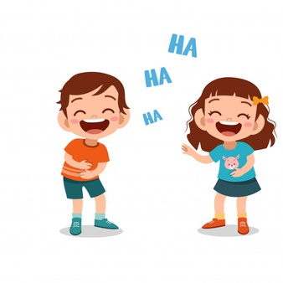
Adding 'ed'
Adding ‘ed’ to a verb changes it to the past tense
e.g. I am jumping and earlier I jumped.
"I love cooking with my Dad and yesterday we __________ dinner".
My friend and I are always laughing and earlier we _________ so much that we cried.
cooked
laughed

Slide 8
Which suffix is added to each of the root words (verb) to complete the sentences? Think carefully about which tense makes sense.
I watched TV with my dad. I am ________ TV with my dad.
Julia is listening to her music on her iPod. Julia ________ to her music on her iPod.
Amena missed the ball. Amena keeps ________ the ball.
The girl was always painting amazing pictures. The girl was a brilliant _________.
Jayden is playing with the dolls. Jayden ________ with the dolls.
watching
listened
missing
painter
played

Slide 9
Activity
Fill in the missing words on the ‘Adding er, ed and ing Spelling Activity’ sheet found on this link:
https://www.twinkl.co.uk/resource/t-l-4300-adding-er-ed-and-ing-spelling-activity

